Slide 1
Script Encoder Decoder
- Adarsh Anand, Anuj Popli
Manager - Arvindh Sabapathy
Mentor - Bhageerath Arasachetty
Mentor – Shyam Prasad
Confidential – © 2022 Oracle Internal/Restricted/Highly Restricted

Slide 2
Agenda
Problem Statement
Project Design
Road Map to project
Technology Exposure
Tools
Demo
Website

Slide 3

Problem Statement
Identify and Encode potentially harmful and vulnerable tags in HTML documents through a Java application. Giving user the flexibility to encode as well as decode the tags and scripts which posses the risk to make the document unsafe.

Slide 4


Project Design
Encoding / Decoding
Writing to Output File
Input HTML Files
Working Directory
Encoding / Decoding
Script Encoder/Decoder
Reads the files in fixed memory blocks for memory optimization
Uses Regex functions to find patterns and encoding the occurrences
Hence disabling the potentially harmful scripts
Writing to Output File
Executor Framework
Spawns Threads
Passes the File Paths and Configurations to
Individual thread
Encoding / Decoding
Writing to Output File
Encoding / Decoding
Writing to Output File
Script Data Binder
Reads configuration passed by the user and creates suitable Data Structures.
Encoding / Decoding
Writing to Output File
4
THREADS

Slide 5
Java Program Flowchart
START
Providing Input File path
Providing Input Folder path
Exit the Program
Wrong Input File Path
Wrong Input Folder Path
Correct Path
Providing Output Folder Path
Wrong Output File Path
Default Output File Path
Choosing Encoding/Decoding Type
Task Successfully Executed
END

Slide 6
Roadmap
To the
Project
Confidential – © 2019 Oracle Internal/Restricted/Highly Restricted

Slide 7
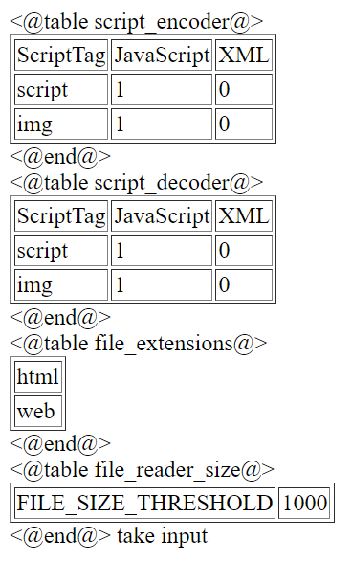
Week 1
Learnt about Java and setup Eclipse
Created a rudimentary code for finding <script> tags and encoding them
Created a ScriptDataBinder class for accessing a configuration file for encoding using a Hashmap of Hashmaps as table
Week 3
Created ScriptEncoder class which reads the input files, encodes/decodes the same and writes the processed file to output folder.
Used Regex function and Patter Matcher in Java to identify the tag patterns.
Using .htm configuration tables for user friendly experience for modifying the configurations
Week 2
The configurations file
Confidential – © 2019 Oracle Internal/Restricted/Highly Restricted

Slide 8
Week 5
Week 6
Using Java Executor Framework and multithreading to simultaneously process many files making the process faster (Reduced processing time by 80%)
Reading whole File in fixed size blocks which makes our program memory efficient and able to handle large files (Max storage usage for a single file of 100mb is 2mb)
Creating tag separated HTML file for all 2600 payloads
Learning about SVN repository and using Tortoise SVN to upload our code files into Oracle Server
Learning about Java Logger and the log4j logger, and then used Java Logger in the program instead of SysOut Functions to manage the logs more efficiently
Successfully testing the code for complete payloads
Reading about and Configuring the log4J logger to log information in log files instead of console.
Creating a separate Script Encoder Decoder Main file which provides functionality to the user to access the program passing the input files and features to be incorporated
Creating executable JAR files file and testing the same with the all payloads
Week 4
Confidential – © 2019 Oracle Internal/Restricted/Highly Restricted

Slide 9
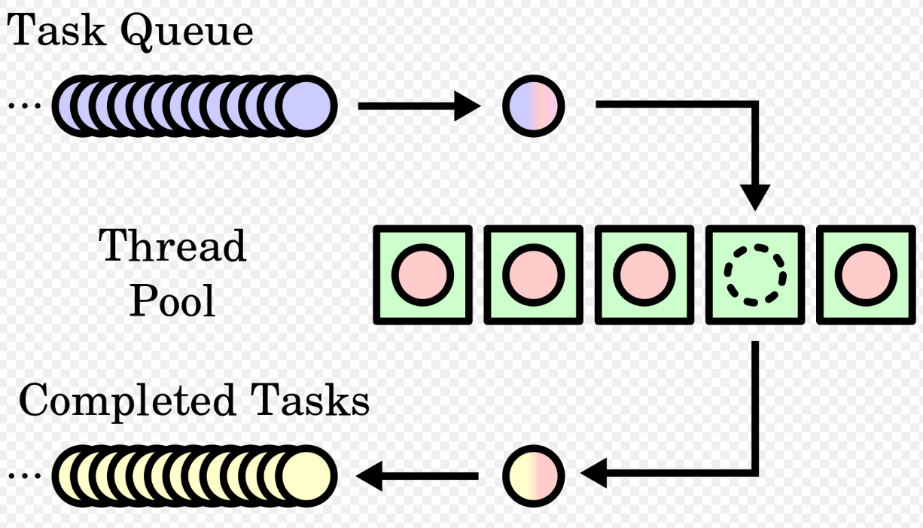
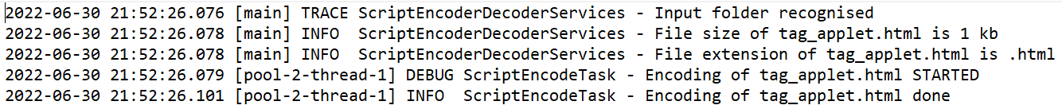
Technology Exposure
Regex for tag identification in encoding/decoding
Executor Framework for thread pooling
"(<|</)" + tag + "[^>]*" + ">"
<script src=1 onerror="javascript:alert(1)">
Log4j for writing logs and maintaining logs
Confidential – © 2019 Oracle Internal/Restricted/Highly Restricted

Slide 10
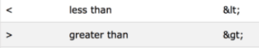
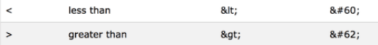
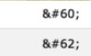
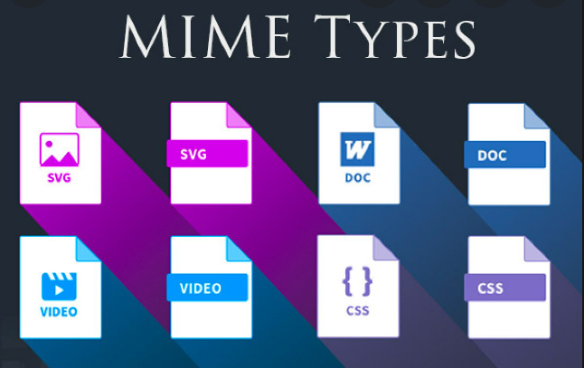

Technology Exposure
HTML Encoding
XML Encoding
MIME type
Github Pages
for escaping the special characters “<“ and ”>” through “&lt;” and “&gt;” so that we can encode our HTML files
for escaping the special characters “<“ and ”>” through “&#60;” and “&#62;” so that we can encode our XML files
for understanding the extension type for any file with a given MIME type
for hosting our website
Confidential – © 2019 Oracle Internal/Restricted/Highly Restricted

Slide 11



Tools used
Eclipse as an IDE and a project management tool
Beyond Compare as tool to compare the text content and merge files
SVN as a repository manager for sharing files among the team
Confidential – © 2019 Oracle Internal/Restricted/Highly Restricted

Slide 12
Demo
Confidential – © 2019 Oracle Internal/Restricted/Highly Restricted

Slide 13
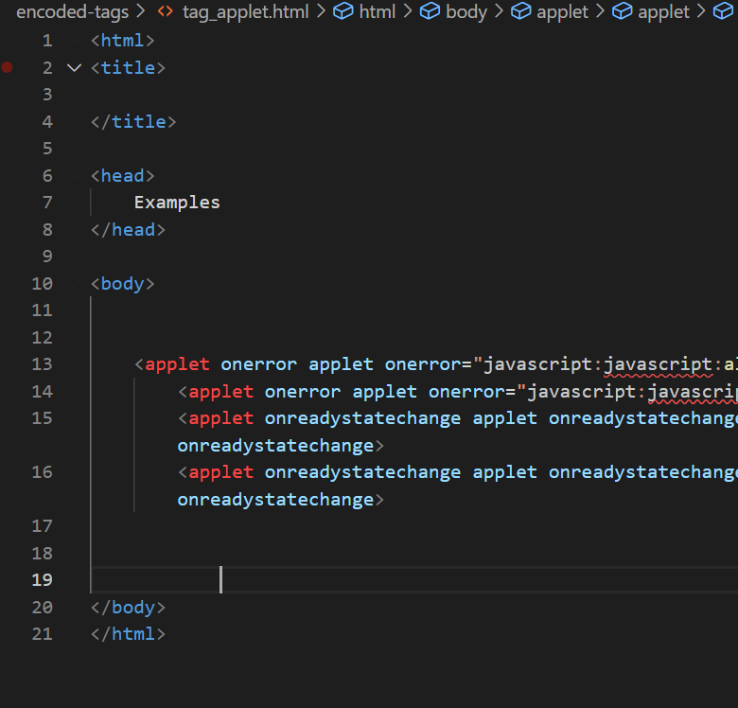
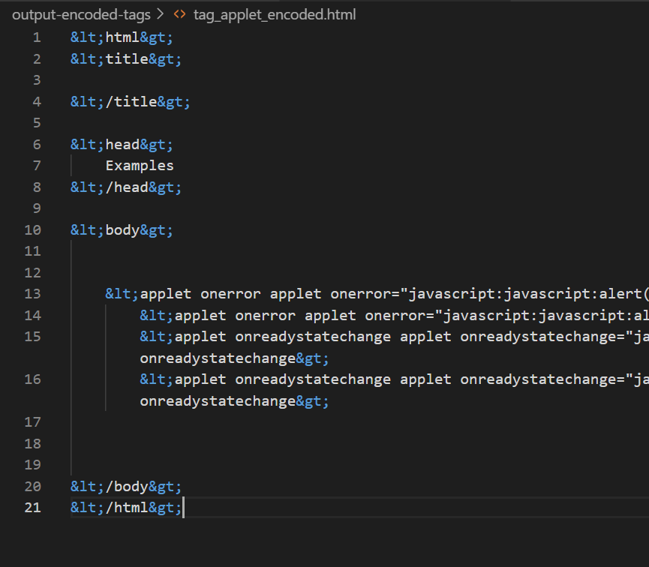
Original HTML file passed to the JAVA program
Encoded File in which tags have been replaced by escape characters

Slide 14
Website
Website demonstrating the working
Example of how the Java Program disables and encodes JavaScript.
Confidential – © 2019 Oracle Internal/Restricted/Highly Restricted

Slide 15
Thank You
Confidential – © 2019 Oracle Internal/Restricted/Highly Restricted

